Slide 1

FINANCIAL FRAUD DETECTION
Team 18
Durga Bhavani Bangari – 001027500
Amulya Rao Ravindra - 001586084

Slide 2
TABLE OF CONTENTS
Introduction
Dataset Description
Analysis
Exploratory Data Analysis
Target Variable
Classification
Data Processing
Modelling
Conclusion
References

Slide 3
1. INTRODUCTION
1.1 Background:
Financial Fraud Detection aims to predict a fraudulent money transaction which is based on sample of real transactions extracted from one month of financial logs from a mobile money service implementation in an African country. This fraud detection system has ‘isFraud’ as the target variable which is detected based on a number of features present in the dataset like the type of transaction made, the amount being transferred, the balance before and after transaction of the person transferring the money and the person who receives the money.
1.2 Goal:
The goal of this project is to get an analysis of the fraud transaction and to classify/predict the fraud detection as accurately as possible. We plan to achieve this by building a machine learning model that learns from the various features present in the dataset and predicts the target variable.

Slide 4
2. DATASET DESCRIPTION
2.1 About the Dataset:
The dataset consists of one month of financial log of mobile money service deployed in an African country.
Size of Dataset : 493MB.
No. of Records : 6362620 rows and 11 columns.
Data Type : Integer datatype only.
Link : https://www.kaggle.com/ntnu-testimon/paysim1
2.2 Dataset Features:
step
type
Amount
nameOrig
oldbalanceOrg
newbalanceOrig
oldbalanceDest
newbalanceDest
isFraud
isFlaggedFraud
nameDest

Slide 5
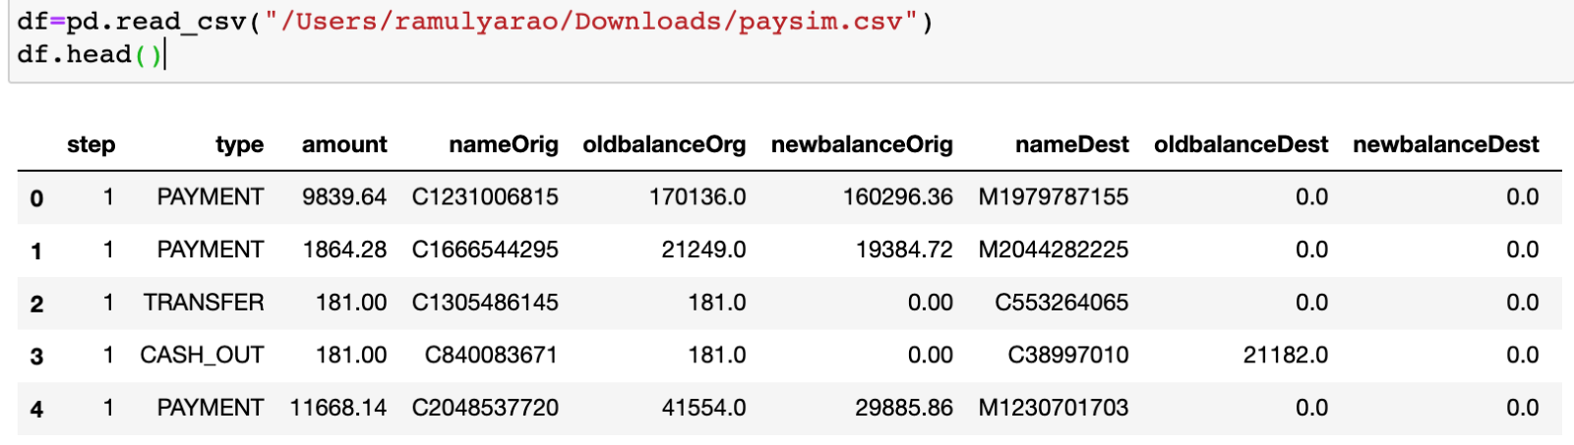
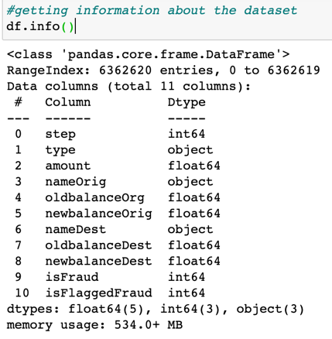
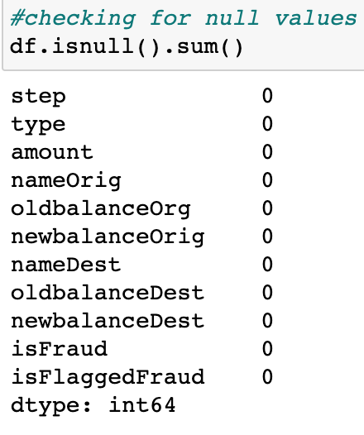
3. ANALYSIS
Dataset load
Dataset Info
Null values Check

Slide 6
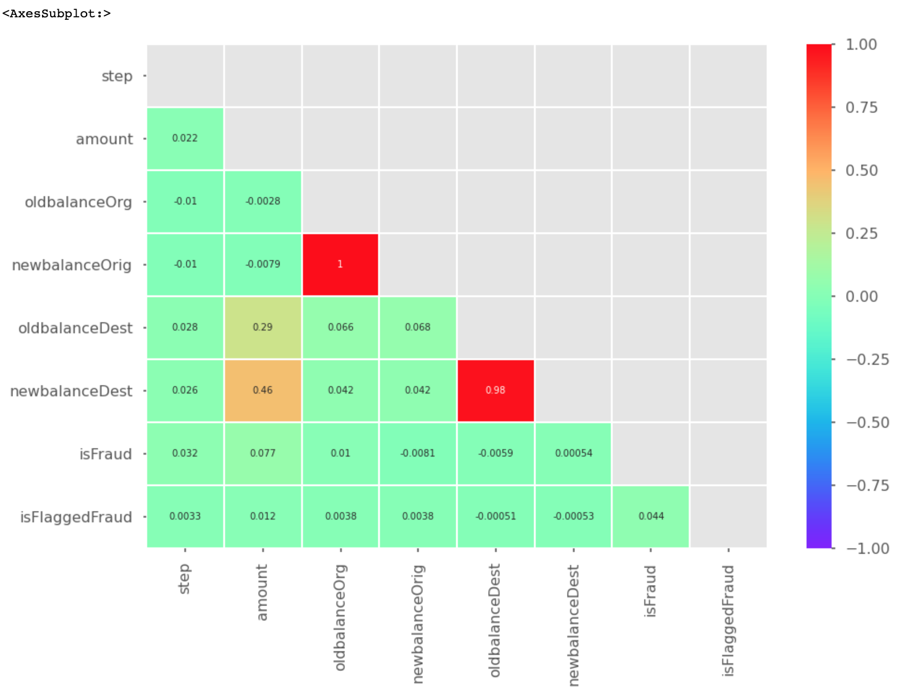
Correlation Matrix

Slide 7

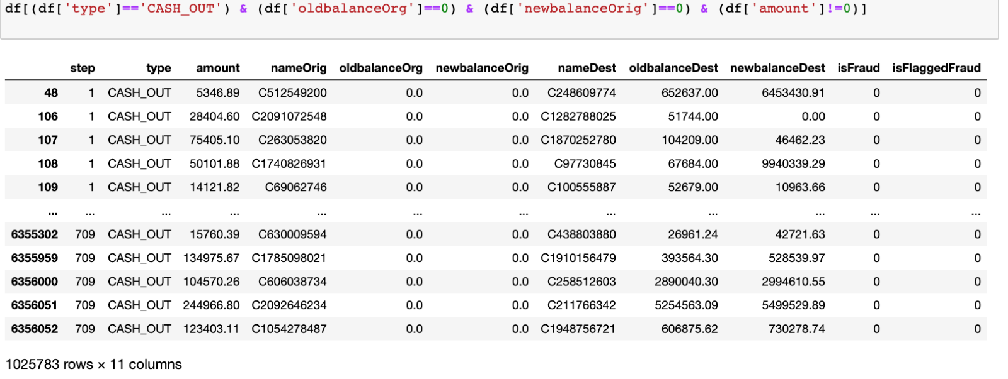
Missing values in all the transaction types:
CASH_IN Type :
CASH_OUT Type :

Slide 8
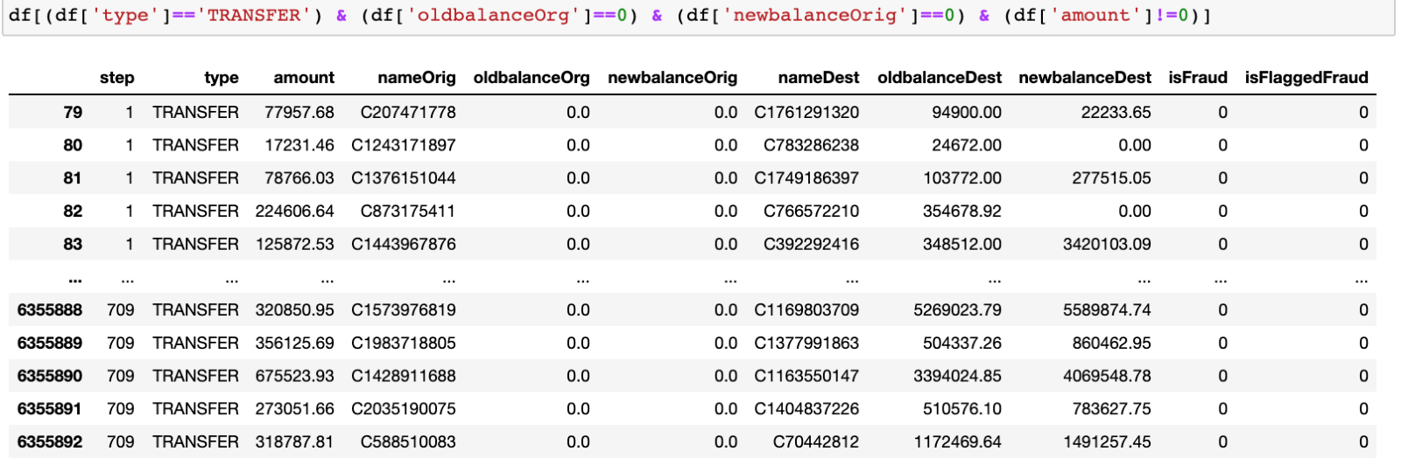
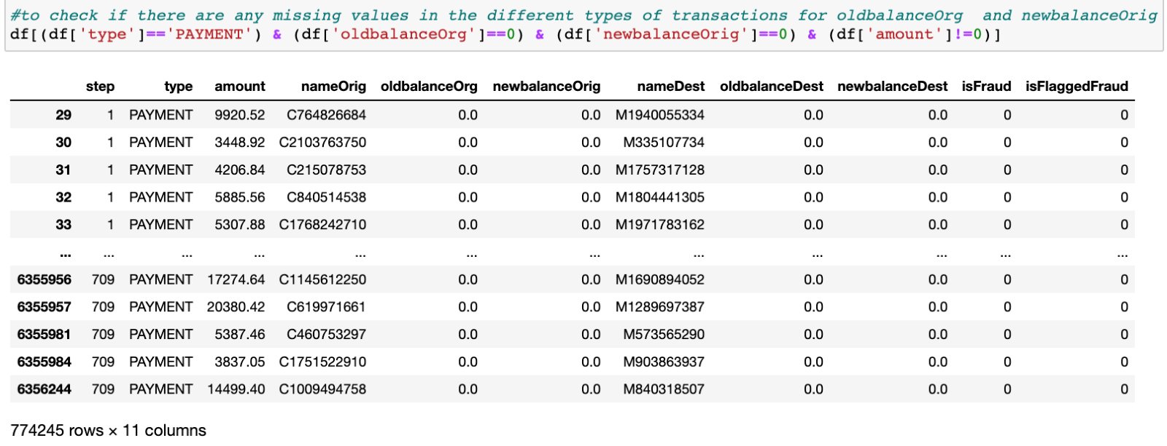
TRANSFER Type :
PAYMENT Type :

Slide 9
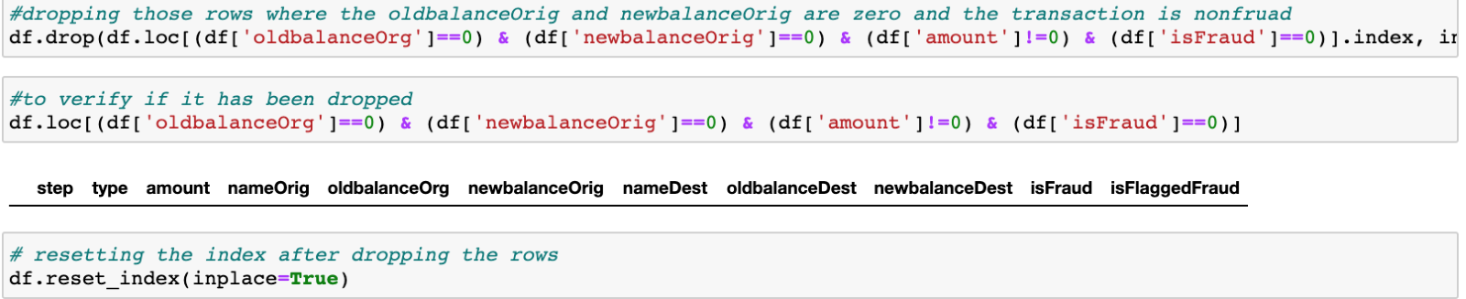
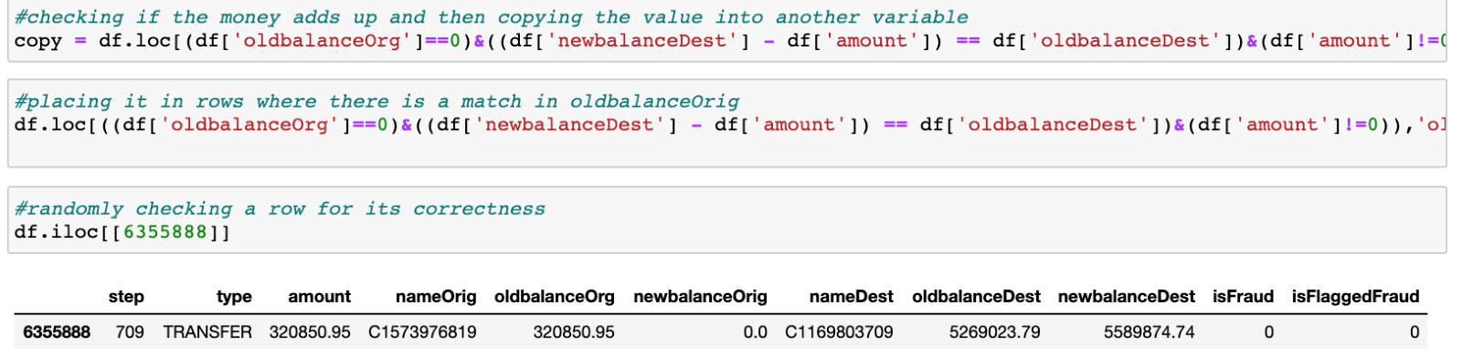
HANDLING MISSING VALUES

Slide 10
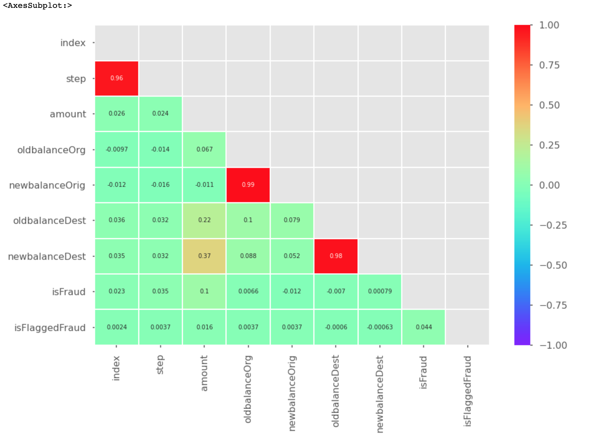
Correlation Matrix after Dropping

Slide 11
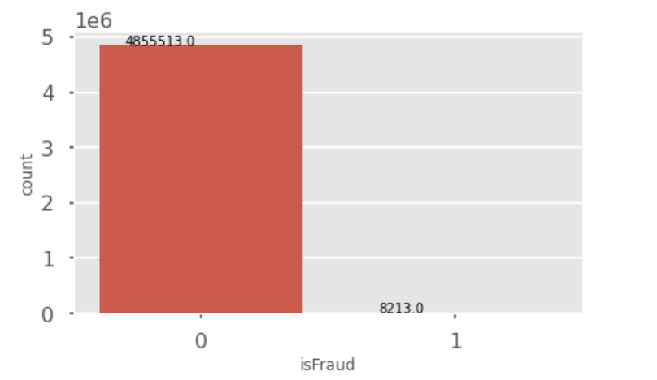
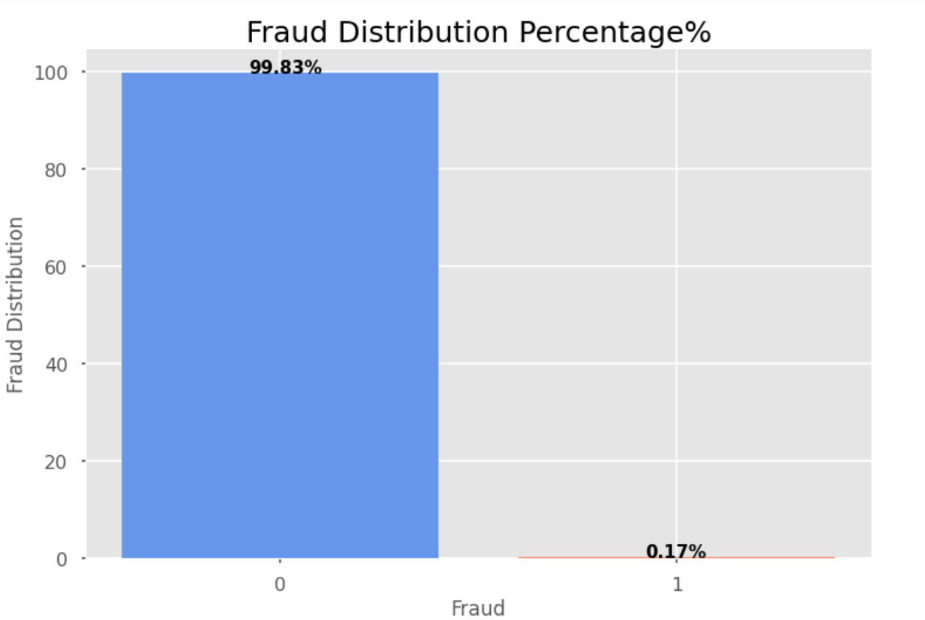
4. EXPLORATORY DATA ANLYSIS
Distribution Of Fraud Vs NonFraud Transactions

Slide 12
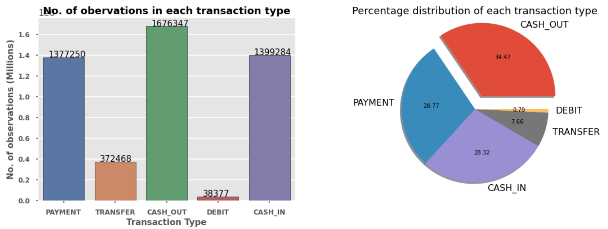
Visualization Of The Transaction Types

Slide 13
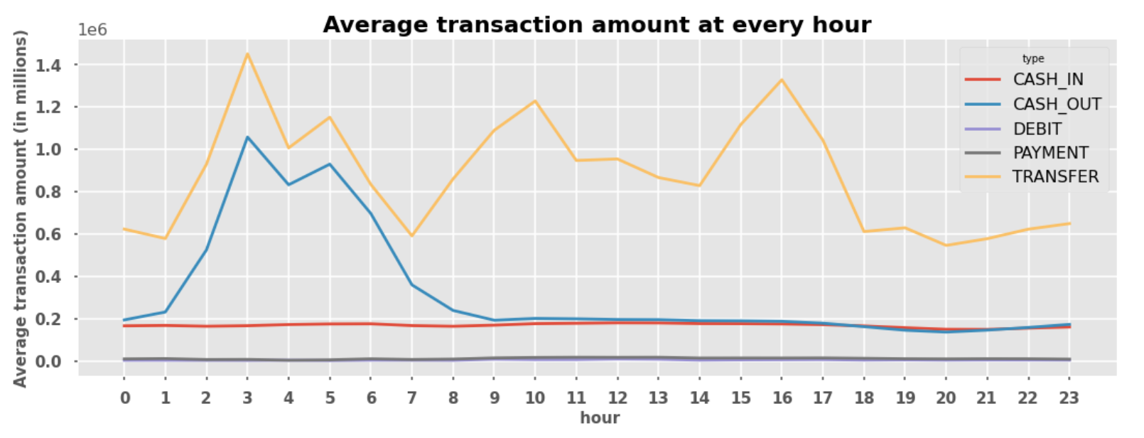
Behavior Of The Transaction Types During The Day

Slide 14
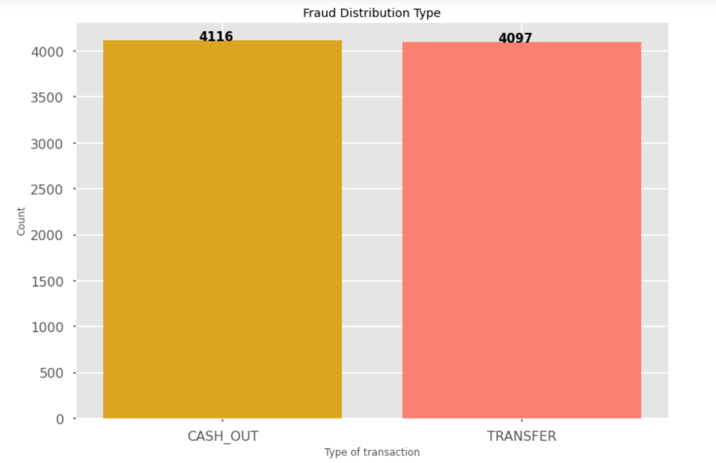
Visualizing The Transaction Types That Cause Fraud

Slide 15

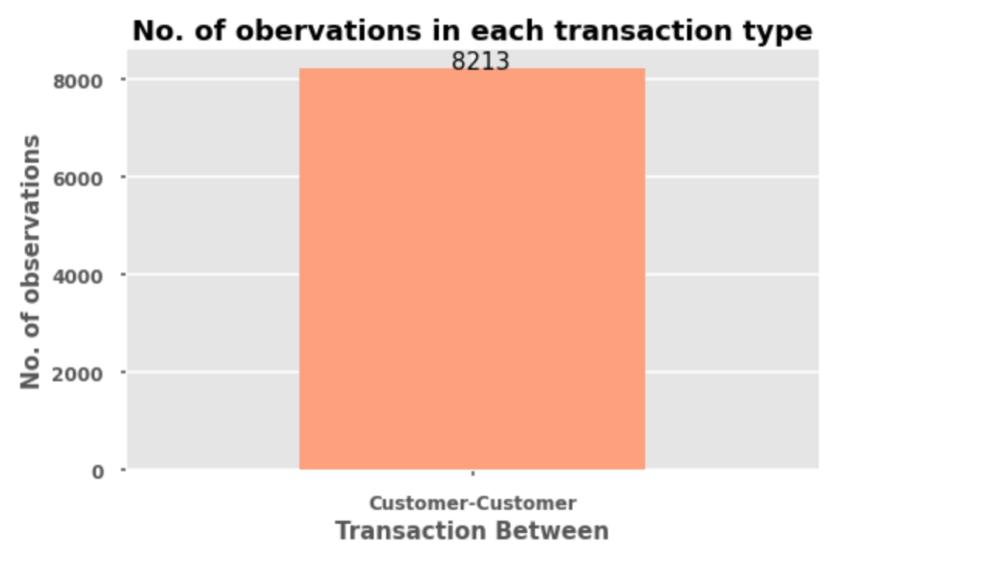
Frauds Are Observed Only Between Customer-Customer Transactions

Slide 16
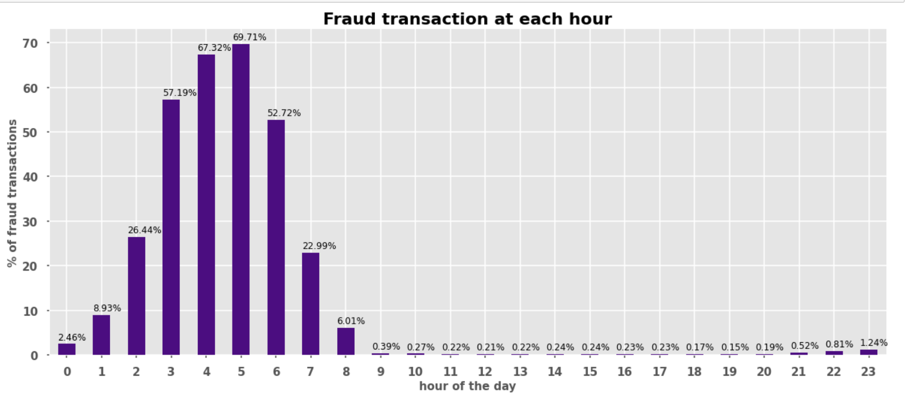
Distribution Of The Fraud Transaction In A Day

Slide 17
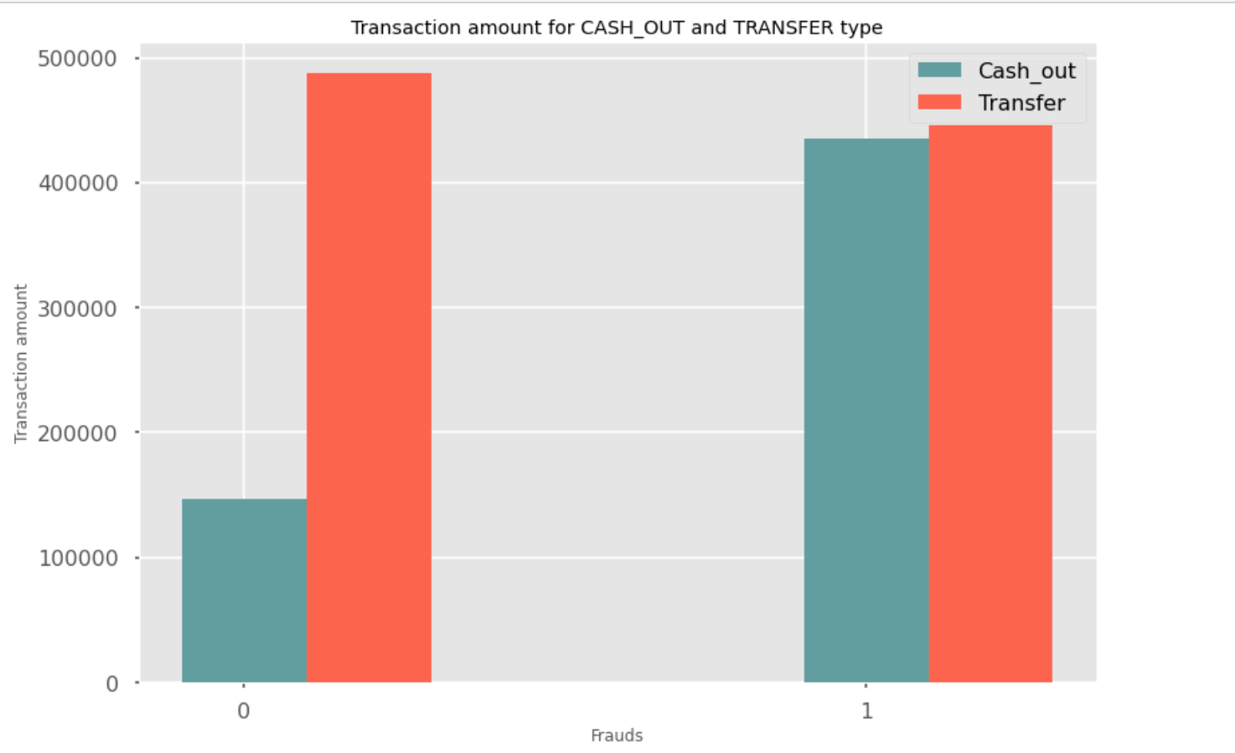
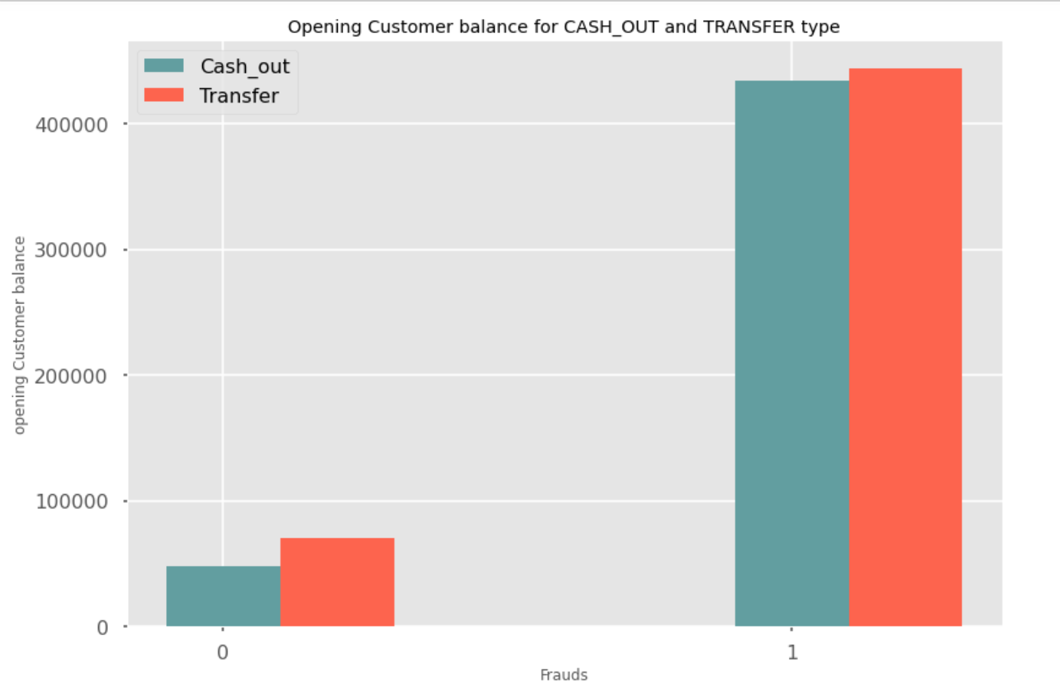
CASH_OUT AND TRANSFER TYPE
Transaction Amount
Customer Opening Balance

Slide 18

5. TARGET VARIABLE
The prediction model that is bult is of classification type. In other words it is built to predict if a particular transaction is fraud or not.
The target variable ‘isFraud’ has two values:
isFraud 0 - not a fraud transaction
isFraud 1- fraud transaction

Slide 19
5. CLASSIFICATION
Logistic Regression
Decision Tree Classifier
Random Forest
K Nearest Neighbors

Slide 20
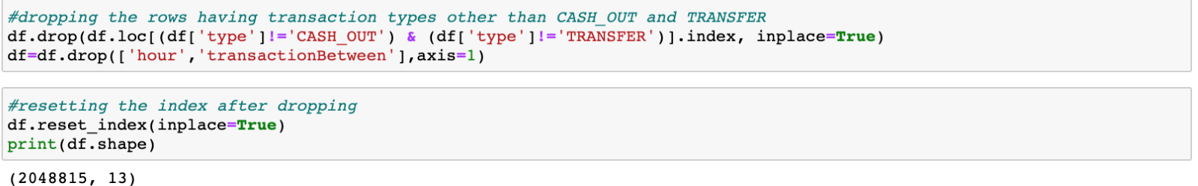
6. DATA PROCESSING
Dropping the three transaction types :
Payment
Debit
CASH_IN

Slide 21
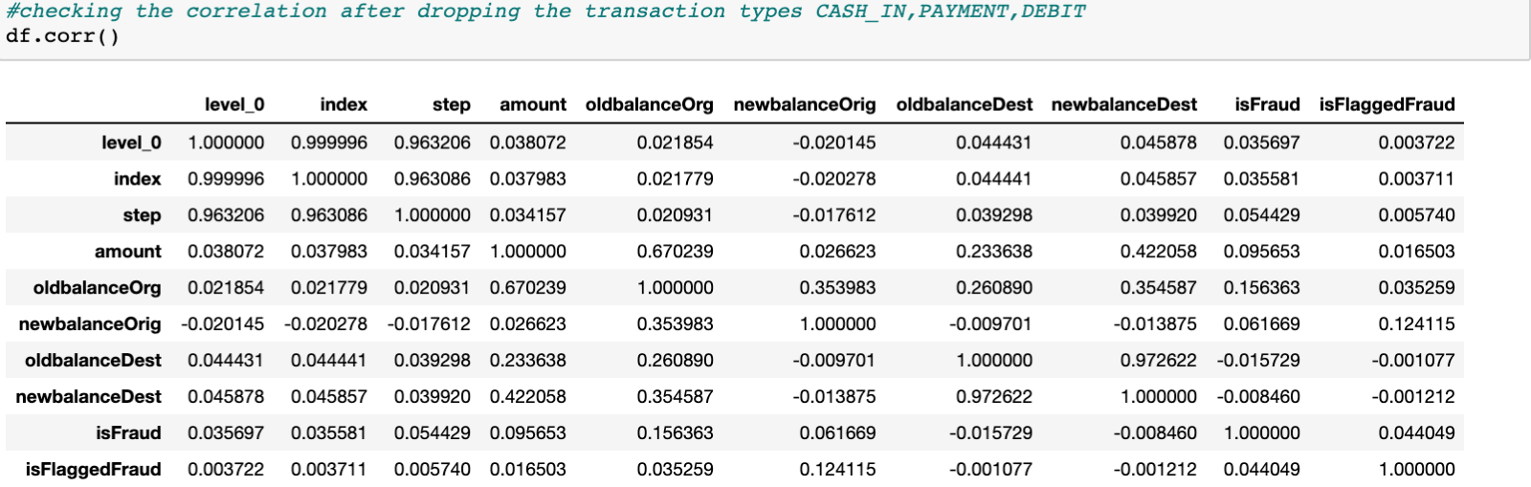
Correlation after Dropping
Correlation Matrix after Dropping

Slide 22
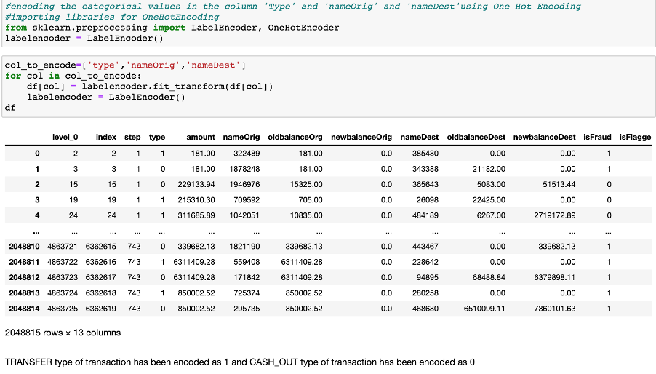
Encoding The Categorical Columns

Slide 23
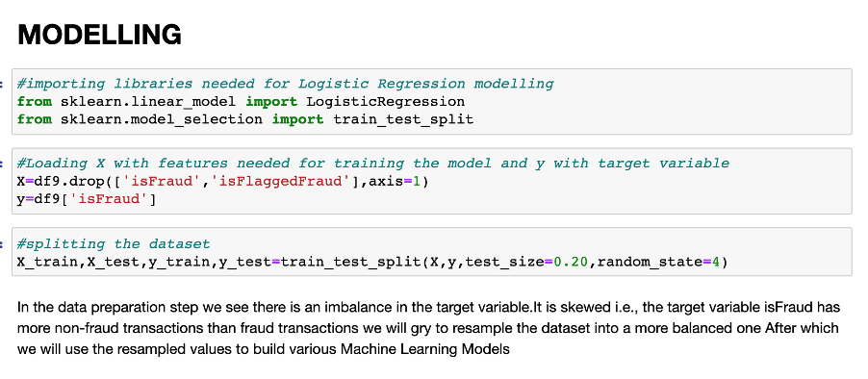
7. MODELLING
Splitting the dataset into train and test sets in the ratio 80:20 respectively.

Slide 24
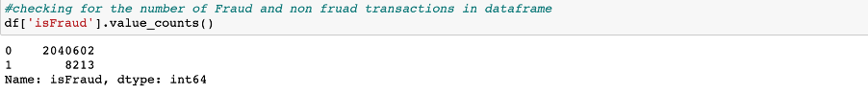
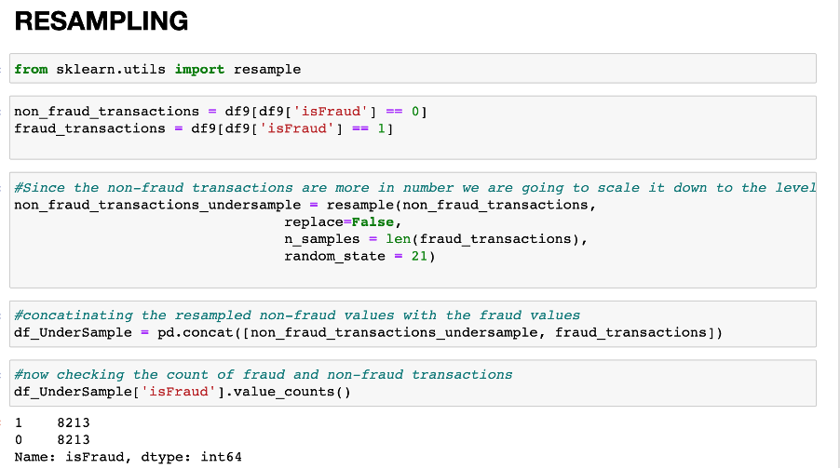
Resampling
Resampling the target variable

Slide 25
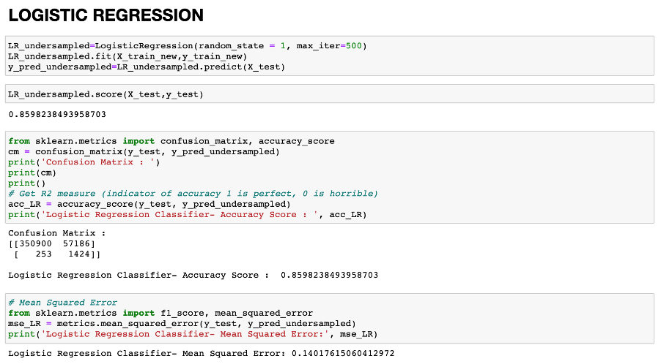
LOGISTIC REGRESSION

Slide 26
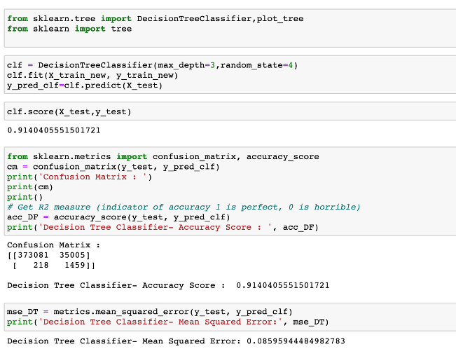
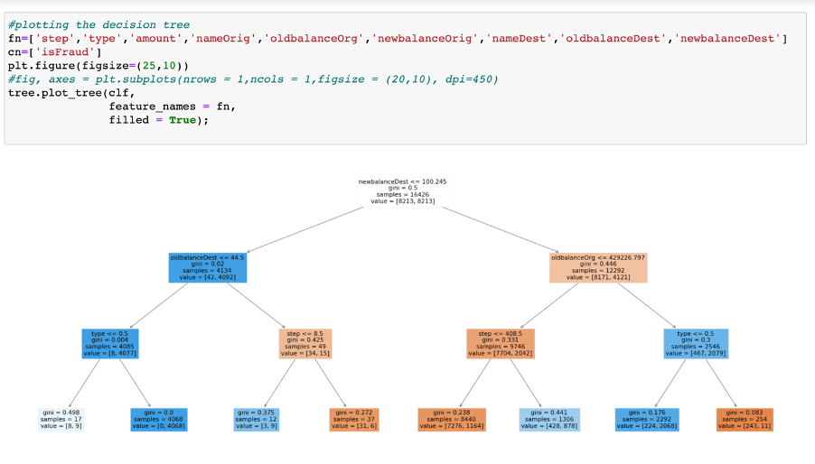
DECISSION TREE

Slide 27
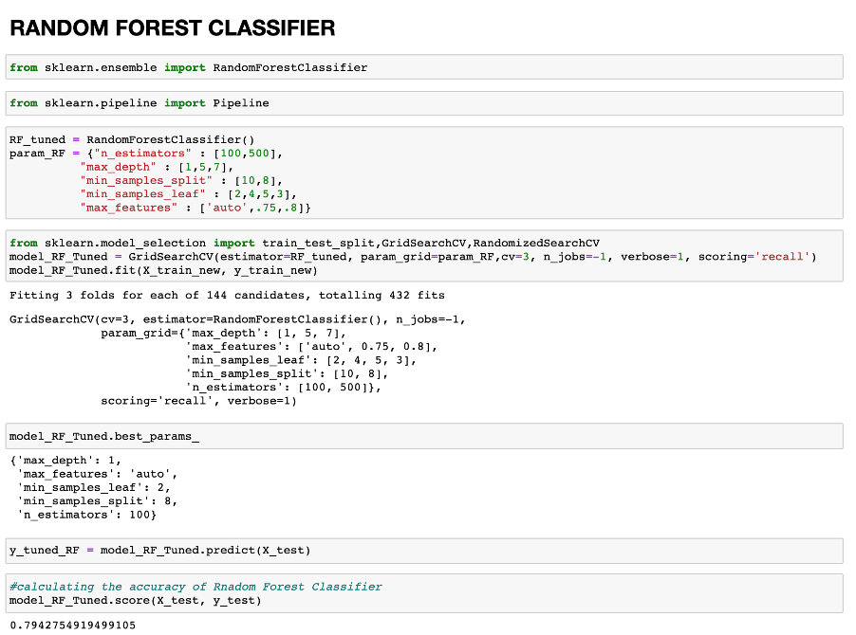
RANDOM FOREST

Slide 28
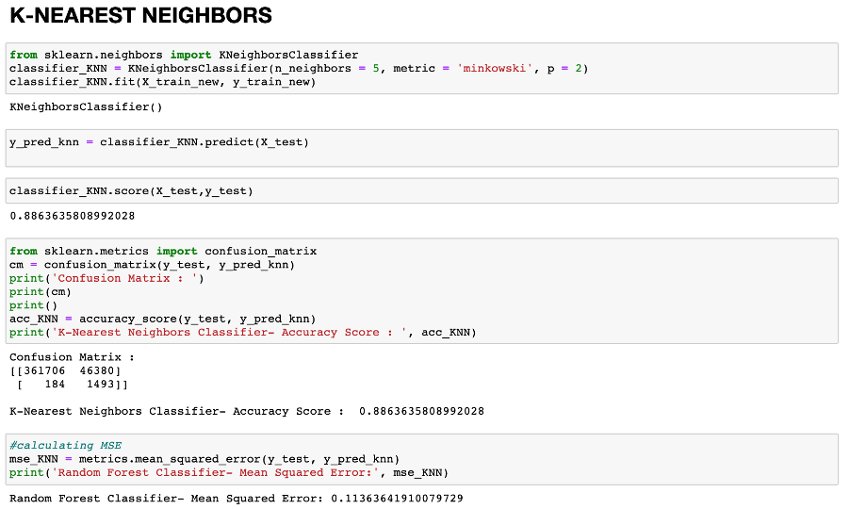
K NEAREAST NEIGHBORS

Slide 29
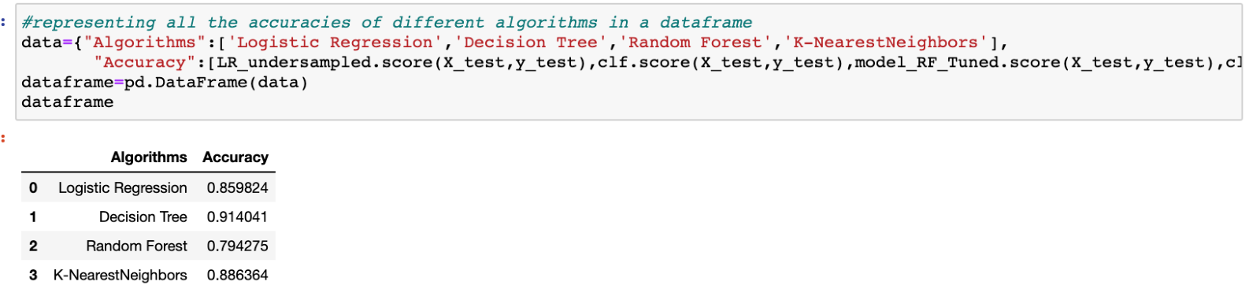
ACCURACY SCORE​ :
Linear Regression Classifier: 86%​
Decision Tree Classifier: 91%​
Random Forest Classifier: 79%​
K-NN Classifier: 89%​

Slide 30
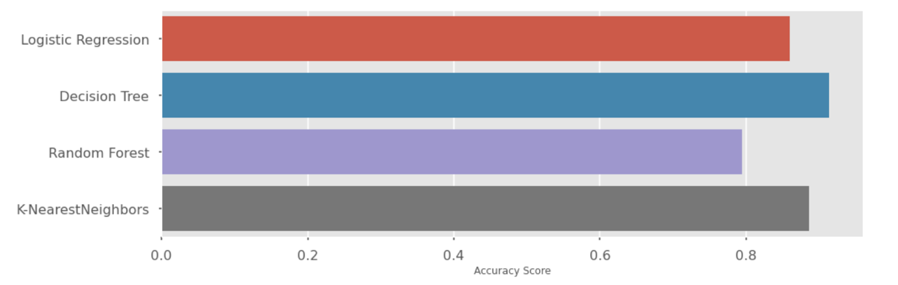
13. VISUALISING THE BEST ALGORITHM

Slide 31
8. CONCLUSION
From the above models used we see that the accuracy score of Decision Tree Classifier is best with the accuracy of 91% in predicting the target variable ‘isFraud’.
From the analysis carried out we see that fraudulent transactions occur only due to CASH_OUT and TRANSFER type of transactions.
Fraudulent transactions occur between Customer-to-Customer transactions.

Slide 32
9. REFERNECES
Fraud Detection: How Machine Learning Systems Help Reveal Scams in Fintech, Healthcare, and eCommerce: https://www.altexsoft.com/whitepapers/fraud-detection-how-machine-learning-systems-help-reveal-scams-in-fintech-healthcare-and-ecommerce/
https://matplotlib.org/stable/api/_as_gen/matplotlib.pyplot.legend.html
https://heartbeat.fritz.ai/resampling-to-properly-handle-imbalanced-datasets-in-machine-learning-64d82c16ceaa
https://towardsdatascience.com/optimizing-hyperparameters-in-random-forest-classification-ec7741f9d3f6
https://medium.com/@ODSC/transforming-skewed-data-for-machine-learning-90e6cc364b0
https://towardsdatascience.com/handling-imbalanced-datasets-in-machine-learning-7a0e84220f28

Slide 33
THANK YOU
THANK YOU

